Slide 1
Attributes & Reflection

Slide 2
Attributes
Attributes – elements that provides a method of associating metadata, or declarative information with code (assemblies, types, methods, properties etc.). After an attribute is associated with a program entity, the attribute can be queried at runtime by using a technique called reflection.
Attributes - classes which directly or indirectly inherits from System.Attribute class.
[Serializable]
public class SampleClass
{
// Objects of this type can be serialized.
}

Slide 3
Attribute Parameters
Many attributes have parameters that allow inclusion of additional information that customizes a program. Parameters can be positional or named. Any positional parameters must be specified in a certain order and cannot be omitted; named parameters are optional and can be specified in any order. Positional parameters are specified first.
[MyAttribute("message", Num = 100)]
class SomeClass
{
//
}

Slide 4
Custom Attributes
Steps to properly design custom attribute classes are as follows:
Applying the AttributeUsageAttribute
Declaring the attribute class.
Declaring constructors
Declaring properties

Slide 5
AttributeUsage
[System.AttributeUsage(System.AttributeTargets.All, AllowMultiple = false, Inherited = true)]
class MyAttribute: Attribute
{
private string info;
private int num;
public MyAttribute (string info)
{
this.info = info;
}
public int Num
{
get {return this.num;}
set {this.num = value;}
}
}

Slide 6
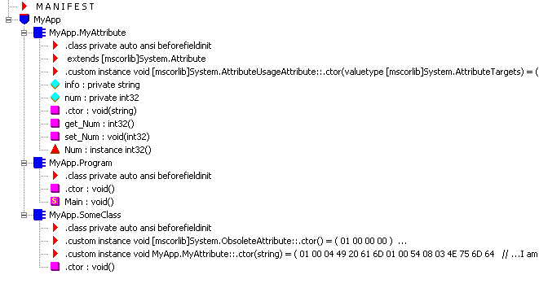

Slide 7
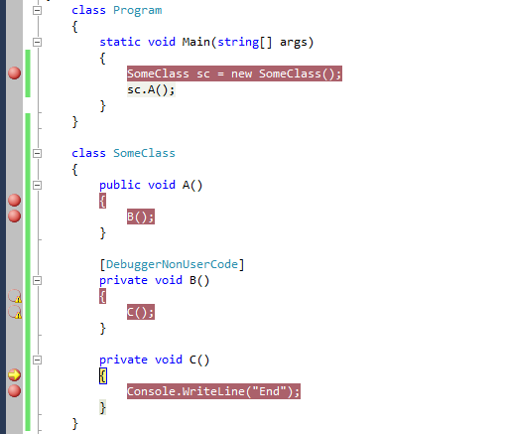
[DebuggerNonUserCode]
[DebuggerStepThrough]
[DebuggerHidden]

Slide 8
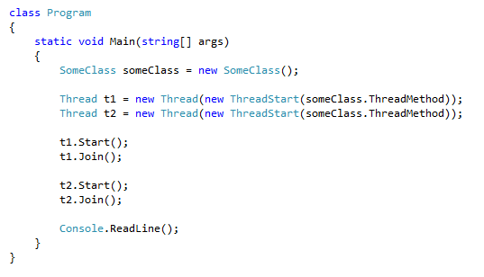
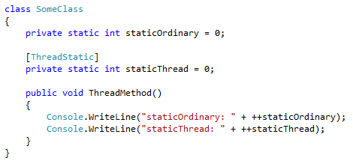

[ThreadStatic]

Slide 9
Reflection
Reflection is the ability of managed code to read its own metadata for the purpose of finding assemblies and types information at runtime.
Reflection :
allows view attribute information at runtime.
allows examining various types in an assembly and instantiate these types.
allows late binding to methods and properties
allows creating new types at runtime and then performs some tasks using those types.

Slide 10
using Reflection;
class Program
{
static void Main(string[] args)
{
System.Reflection.MemberInfo info = typeof(MyClass);
object[] attributes = info.GetCustomAttributes(true);
for (int i = 0; i < attributes.Length; i++)
{
Console.WriteLine(attributes[i]);
}
}
}

Slide 11
class SomeClass
{}
class Program
{
static void Main()
{
//apply to class
Type type2 = typeof(SomeClass);
//apply to object
SomeClass someClass = new SomeClass();
Type type3 = someClass.GetType();
}
}

Slide 12
Late binding
Late binding is a runtime process of looking up a declaration, by name, that corresponds to a uniquely specified type. It does not involve type checking during compilation, when referencing libraries, including an object, is not required.

Slide 13
using System;
namespace SomeAssembly
{
public class SomeClass
{
public SomeClass()
{
}
public string SomeMethod(string firstName, string lastName)
{
return firstName + "-" + lastName;
}
}
}

Slide 14
using System;
using System.Reflection;
namespace MyApp
{
class Program
{
static void Main()
{
try
{
Assembly assembly = Assembly.Load("SomeAssembly");
Type type = assembly.GetType("SomeAssembly.SomeClass");
ConstructorInfo ctor = type.GetConstructor(new Type[] {});
//Create object
object obj = ctor.Invoke(null);
//or object obj = Activator.CreateInstance (type);

Slide 15
MethodInfo method = type.GetMethod("SomeMethod");
string[] parameters = new string[2];
parameters[0] = "Lv";
parameters[1] = "273";
string name = (string)method.Invoke(obj, parameters);
Console.WriteLine(name);
}
catch (Exception exc)
{
Console.WriteLine(exc.Message);
}
}
}
}

